Slide 1
WorthTheWeight
Storyboard Capstone
Katelynn Dunn

Slide 2
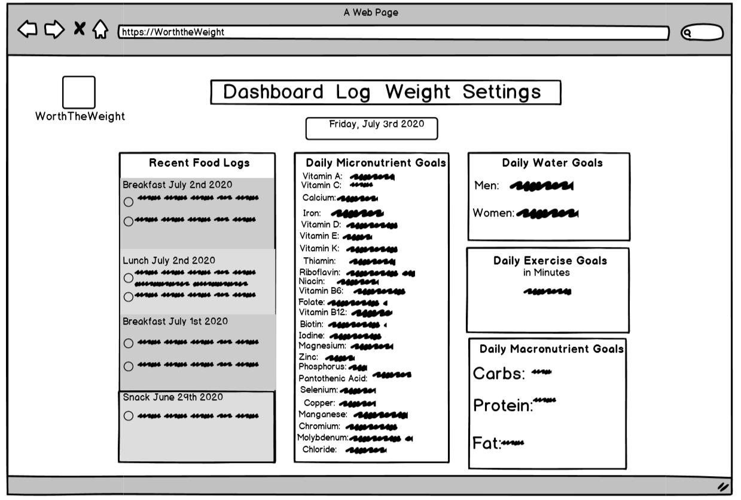
Dashboard Page
Once a user logs into account, this is the page they are shown.
User can be directed back to this page by clicking “Dashboard” in the navigation bar at the top of the web page.
User can access Log page by clicking on “Log” in the navigation bar at the top of the page.
User can access Weight page by clicking on “Weight” in the navigation bar at the top of the page.
User can access Settings page by clicking on “Settings” in the navigation bar at the top of the page.
They can also click the “WorthTheWeight” Icon which will direct them to the dashboard.
User can look at overview of daily specifics on dashboard.
When a user clicks on recent food logs, daily macros and micros, daily water and daily exercise it takes them to the log page.
This page has no editing features, this shows an overview of what a user would need in a day.

Slide 3
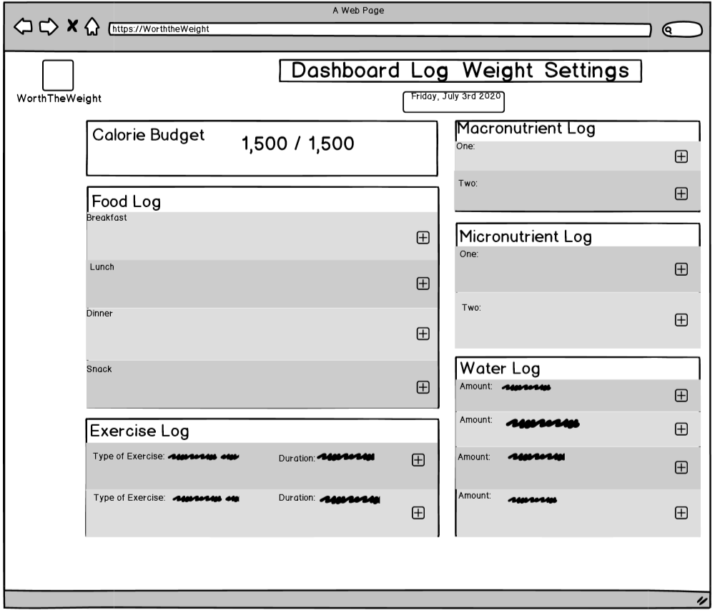
Log Page
User can access this page by clicking “Log” in the navigation bar.
User can access Dashboard by clicking “Dashboard” in the navigation bar at the top of the page.
User can access Weight page by clicking “Weight” in the navigation bar at the top of the page.
User can access Settings page by clicking “Settings” in the navigation bar at the top of the page.
User can access the Dashboard by clicking the “WorthTheWeight” icon in the top left.
User can add/edit food items to meals of the day by clicking on the plus icon in the right of the meal.
User can edit/add exercise by clicking on the plus icon in the exercise log, adding the type of exercise and the duration.
User can edit/add macronutrients by clicking on the plus icon in the macronutrient log.
User can edit/add micronutrients by clicking on the plus icon in the micronutrient log.
User can edit/add water by clicking on the plus icon in the water log and entering the amount.

Slide 4
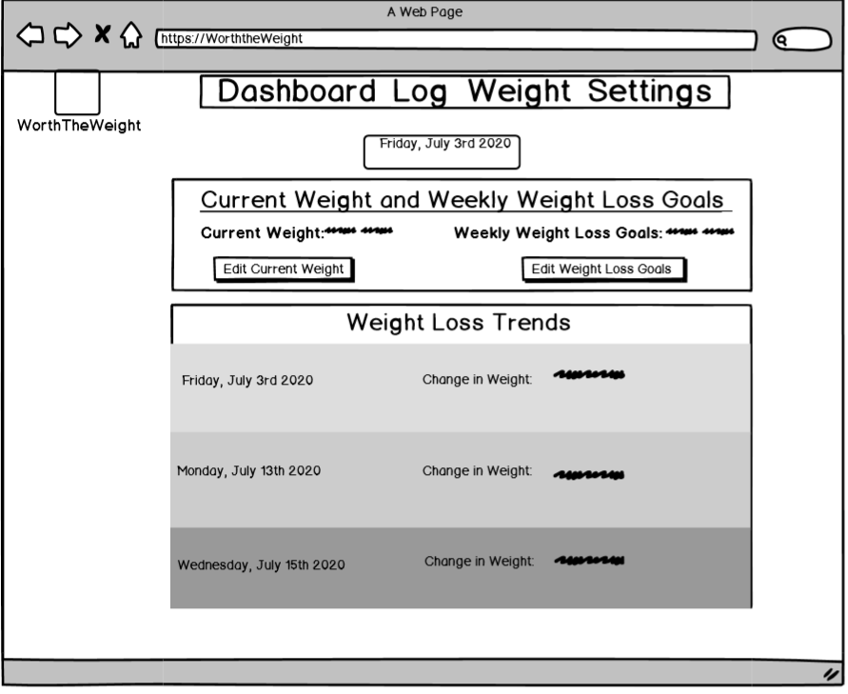
Weight Page
User can access this page by clicking on “Weight” in the navigation bar.
User can access Dashboard page by clicking “Dashboard” in the navigation bar at the top of the page
User can access Log page by clicking “Log” in the navigation bar at the top of the page.
User can access Settings page by clicking “Settings” in the navigation bar at the top of the page.
User can edit current weight by clicking the “Edit Current Weight” button
User can edit weekly weight loss goals by clicking the “Edit Weight Loss Goals”
When a user clicks the “WorthTheWeight” icon, they will be directed to the dashboard.

Slide 5
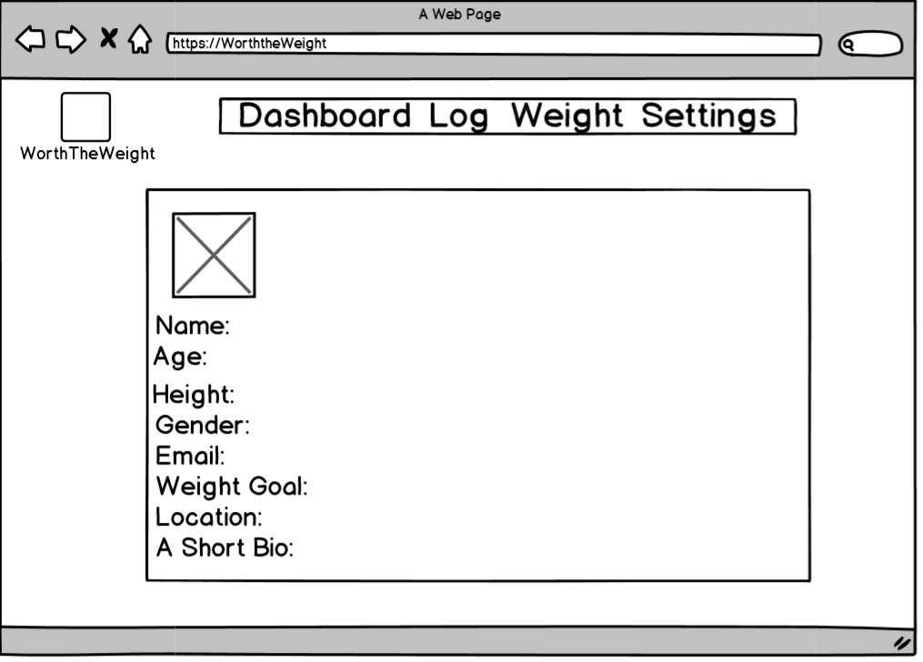
Settings/Profile Page
User can access this page by clicking “Settings” in the navigation bar.
User can access Dashboard by clicking “Dashboard” in the navigation bar at the top of the page.
User can access Weight page by clicking “Weight” in the navigation bar at the top of the page.
User can access Log page by clicking “Log” in the navigation bar at the top of the page.
User can access the Dashboard by clicking the “WorthTheWeight” icon in the top left.
User can edit/add picture to profile by clicking on profile picture image placeholder.
User can edit/add Name, Age, Height, Gender, Email, Weight Goal, Location and Short Bio by clicking in empty space next to area and typing in information.

Slide 6
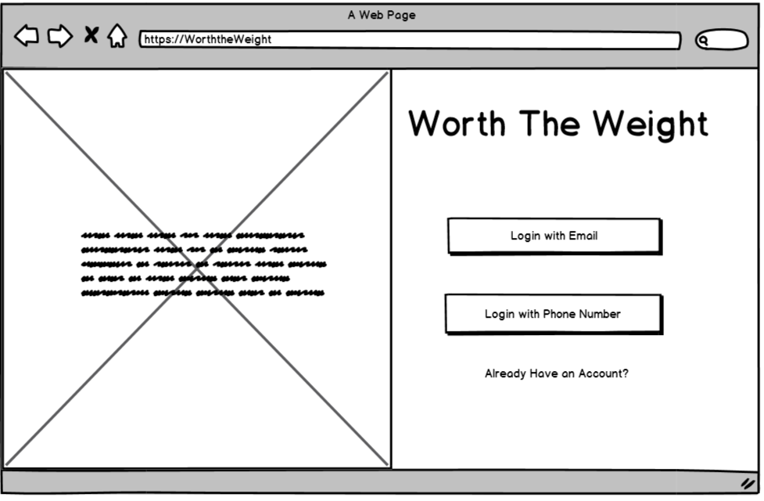
Login Page
Users can login with email by clicking the “Login with Email” button
Users can login with phone number by clicking the “Login with Phone Number” button
Users can click the “Already have an Account?” link to access the return user login screen.

Slide 7
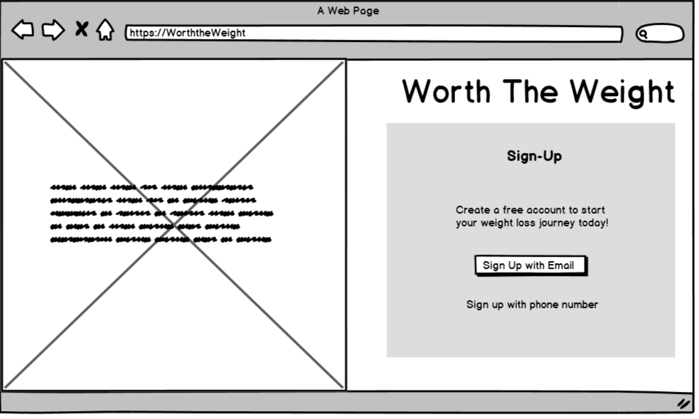
Sign-Up with Email Page
Users can sign up for a new account with an email by clicking the “Sign Up with Email” button.
Users can access sign up with phone number page by clicking “Sign up with phone number” link.

Slide 8
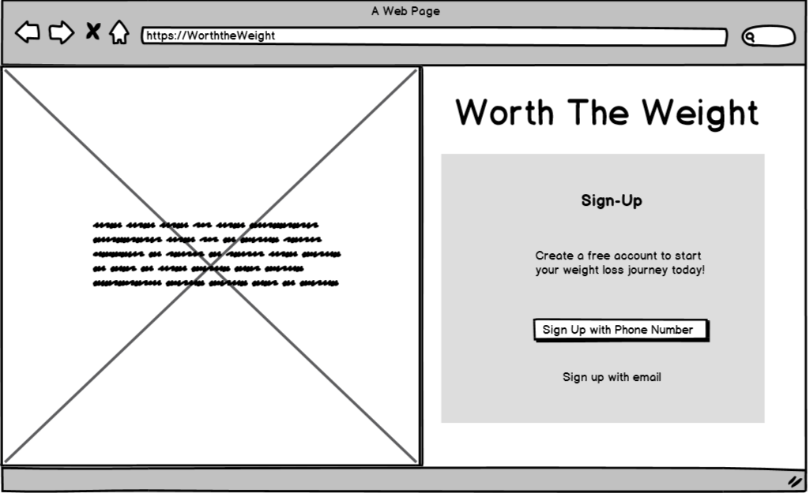
Sign-Up with Phone Number Page
Users can sign up for a new account with a phone number by clicking the “Sign Up with Phone Number” button.
Users can access the sign up with email page by clicking the “Sign up with email” link.

Slide 9
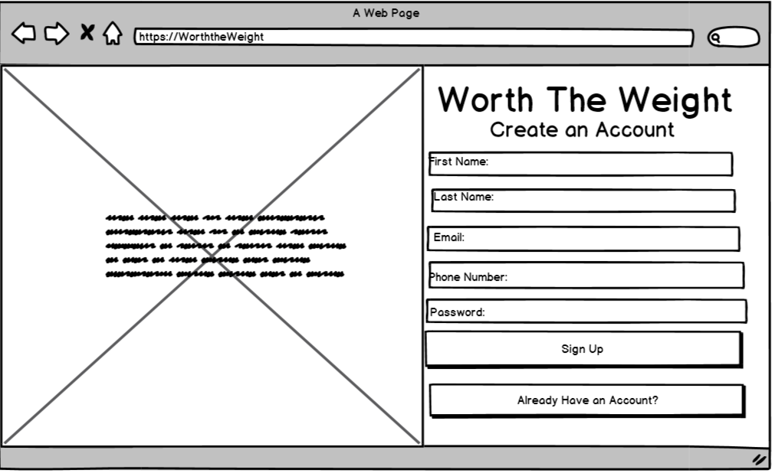
Create an Account Page
Users can add first name, last name, email, phone number and password by clicking in the box and typing out what is asked.
Users can sign up for an account by filling out the first name, last name, email, phone number and password fields and clicking the “Sign Up” button.
Users can access the returning user login page by clicking the “Already Have an Account?” button.

Slide 10
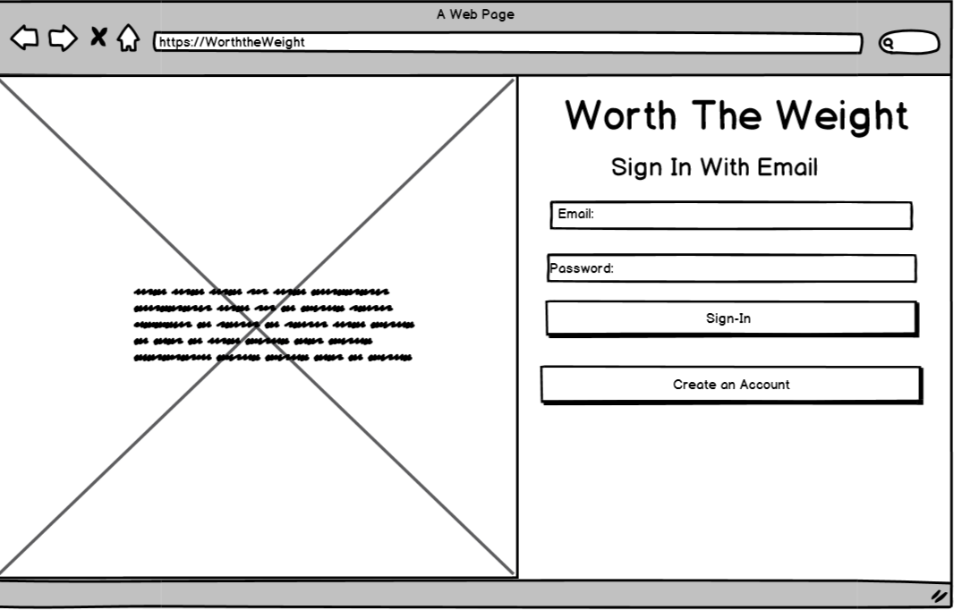
Sign-In with Email Page
Users can enter in email and password by clicking in boxes and typing out designated field.
User can sign into an existing account by filling in email and password fields and clicking the “Sign In” button.
User can access the create an account page by clicking the “Create an Account” button.

